Slide 1
Theia/Blindsight
Final Presentation
CARZ: Charlie Wong, Alec Yeasting, Riley Hunter, Zach Gherman

Slide 2
As-Is/To-be Scenario 1
As is:
Abe does not like the voice that typical computer speech applications use
Abe wants to set a preferred contact for emergency situations
Abe does not like receiving too much information at once
To be:
Abe has his friend change the settings on the type of voice for the application to use
Abe has his friend set a preferred contact for emergency situations
Abe has his friend set how much information to receive from the application during navigation
Abe’s friend saves his settings to his account
Accomplished:
None of this scenario

Slide 3
As-Is/To-be Scenario 2
As is:
Richard is on his way to a lecture
On the way Richard falls and breaks his leg, unable to get up
Richard has no way of easily getting help because nobody is around
To be:
After Richard’s fall and after short time not moving Blindsight asks Richard if he has fallen
The application then asks Richard if he would like to call emergency services
Richard gets EMS support for his broken leg so he can get the medical care he needs
Accomplished:
None of this scenario

Slide 4
As-Is/To-be Scenario 3
As is:
Stevie is trying to go to his next classroom. He knows he needs to walk ahead a few steps, and then turn left around the corner
However, he is not sure when to turn
He took a guess, but turned too early, hit the wall and hurt his head
To be:
The Theia app asks Stevie to give his destination (location is also asked in permissions, but is implicit at the point of using the application to find the route).
The app calculates the route from the current location to the destination
BlindSight tells Stevie to “walk ahead 10 steps, then turn left”
Accomplished:
All of the to be scenario in prototype form (Uses feet instead of steps for greater consistency)

Slide 5
Creep Rate Revist
Our original maximum allowable creep rate was determined to be: 32%
Our number of function points at the end of phase 1 was: 73 function points
To go over our maximum allowable creep rate for the one month since phase 1 we would have to be at: 97 function points
Our current number of function points is: 79 function points
That means our creep rate for the last month was: 8%
This creep rate is within our predetermined acceptable creep rate. This creep rate has been manageable so far and because we are capable of a higher creep rate we have no reason to doubt our maximum creep rate estimate at the moment.
Notes:
We are not showing our calculations on this slide. However, we can provide a document with the calculations.

Slide 6
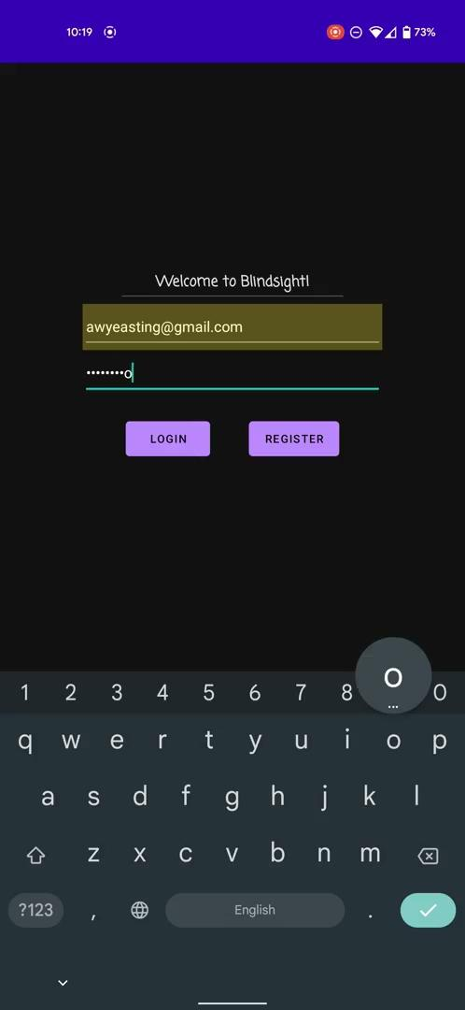
Demo
Backup video :
(if android screen mirroring is unreliable):

